Slide 1
Hard D Benchmark
Albu Alexandra
Birescu Darius
Birla Cristian-Nicolae
Dariciuc Alexie
Dondera Ionut-Catalin
Gut Ioan Filip

Slide 2
INTRODUCTION
About HDDs
Benchmarking software
DESIGN AND IMPLEMENTATION
STATE OF THE ART
CrystalDiskMark vs. Hard D Benchmark
USAGE
Steps to using Hard D Benchmark
RESULTS

Slide 3
1. INTRODUCTION
What is an HDD?
A hard disk drive (HDD), hard disk, hard drive or fixed disk is a data storage device that uses magnetic storage to store and retrieve digital information using one or more rigid rapidly rotating disks (platters) coated with magnetic material. The platters are paired with magnetic heads, usually arranged on a moving actuator arm, which read and write data to the platter surfaces. Data is accessed in a random-access manner, meaning that individual blocks of data can be stored or retrieved in any order and not only sequentially. HDDs are a type of non-volatile storage, retaining stored data even when powered off.

Slide 4
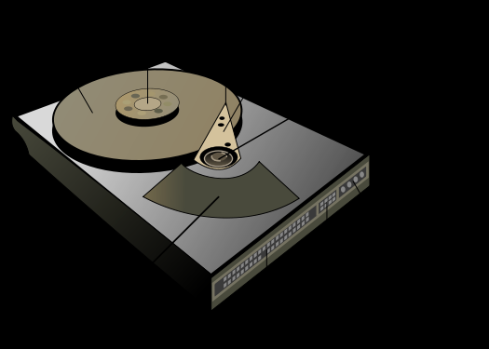
Head
Spindle
Platter
Actuator arm
Actuator axis
Power
connector
Actuator
IDE connector
Jumper block

Slide 5
About HDDs
The primary characteristics of an HDD are its capacity and performance.
Capacity is specified in unit prefixes corresponding to powers of 1000: a 1-terabyte (TB) drive has a capacity of 1,000 gigabytes. Typically, some of an HDD's capacity is unavailable to the user as it is used by the file system and the computer operating system.
Performance is specified by the time required to move the heads to a track or cylinder (average access time) plus the time it takes for the desired sector to move under the head (average latency), and finally the speed at which the data is transmitted (data rate).

Slide 6
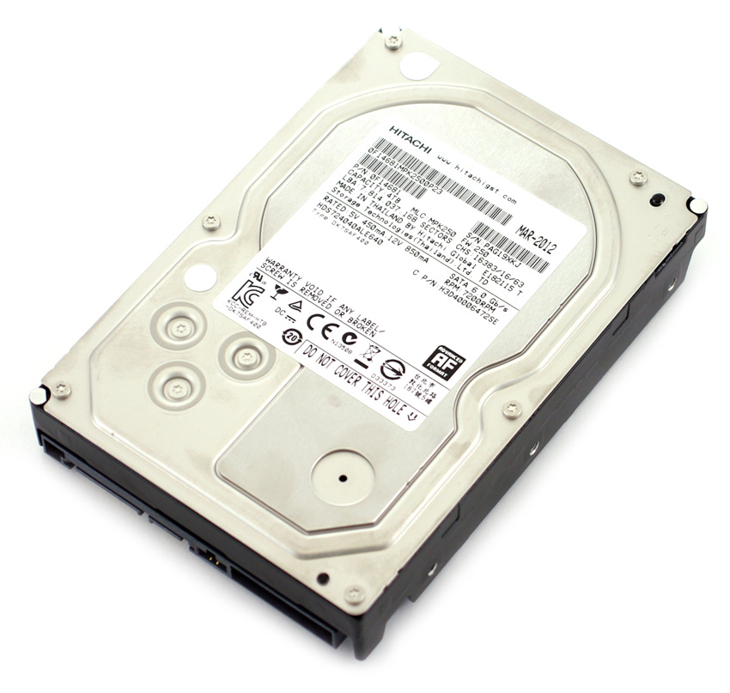
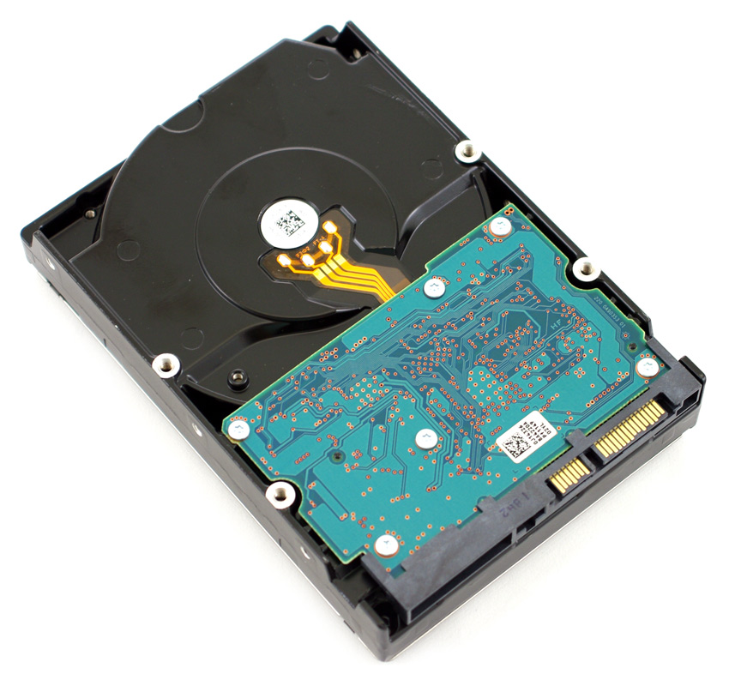
HDD top side
HDD bottom side

Slide 7
Benchmarking software
A benchmark is the act of running a computer program, a set of programs, or other operations, in order to assess the relative performance of an object, normally by running a number of standard tests and trials against it.
Benchmarking is usually associated with assessing performance characteristics of computer hardware, for example, the floating point operation performance of a CPU, but there are circumstances when the technique is also applicable to software. Software benchmarks are, for example, run against compilers or database management systems.
Benchmarks provide a method of comparing the performance of various subsystems across different chip/system architectures.

Slide 8
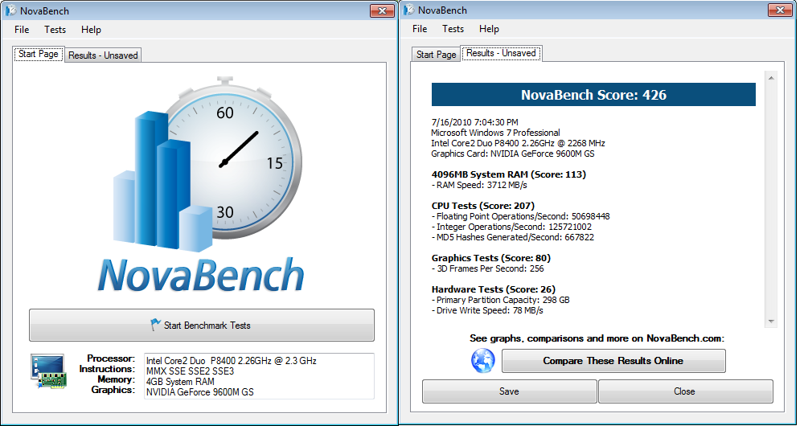
Novabench is a free benchmarking software. Simply hit the ‘Test’ button and it will run a series of tests over 1-2 minutes. It spits out an overall score and individual hardware measurements for CPU, GPU, RAM, and drive write speed.

Slide 9
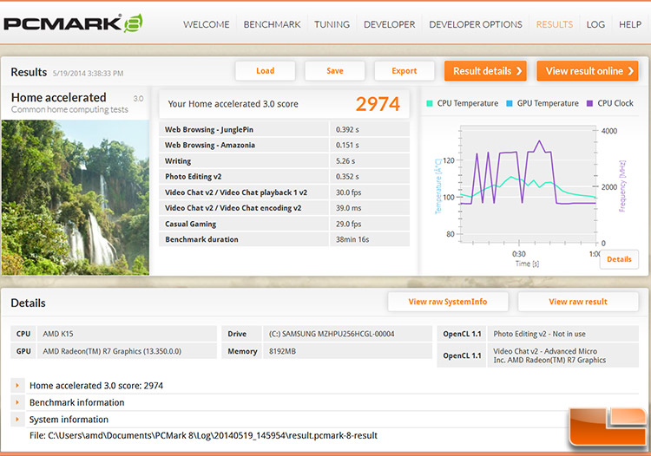
PCMark software is a very good way to measure overall PC performance for home and creative use. Tests will measure your PC’s abilities for web browsing, gaming, media creation, and more. It also includes storage tests for SSDs, HDDs, external drives, and hybrid drives.

Slide 10
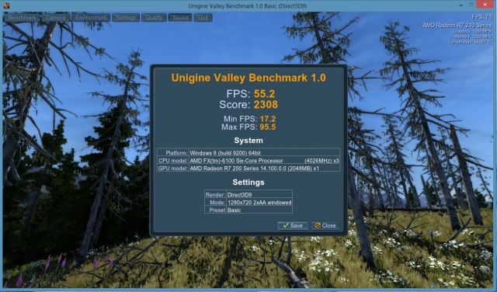
Valley and Heaven are two GPU stress tests that can also work as benchmarking tools. Both tests run your graphics card through the ringer to see how much it can handle.

Slide 11
2. DESIGN AND IMPLEMENTATION
Key features:
The user can change the size of the file and the buffer size.
Simplicity in UI – run a series of tests just by clicking a button,
Interactive graph that shows the speed of the operation
Wide range of customization- user can select different buffer and file sizes
Results in the form of an interactive graph- the user can zoom in/out and save it in different formats (PNG,SVG,PDF).
The interaction between the GUI and the functional part of the benchmark takes place through a single class, the BenchmarkControlSingleton which launches every request on a separate thread and also handles access to HDD/SSD to ensure that there won’t be two IO operations taking place at the same time, as they might influence the result. Future requests are queued in a separate thread which waits for the IO dedicated thread to finish.

Slide 12
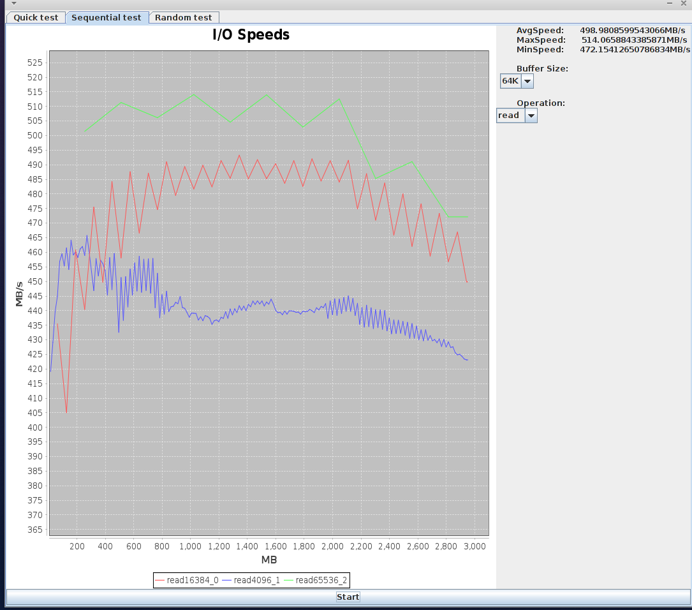
Select the test
Speed results in MB/s
Select buffer size and operation
Graphical plot of the results
Start test

Slide 13
3. STATE OF THE ART
CrystalDiskMark is a piece of software that allows you to benchmark your hard drive (HDD) or solid state drive (SSD) to make sure that it is performing optimally.
CrystalDiskMark lets you select any drive that you want and perform a number of tests on them to measure performance for reading and writing. It will run sequential read & write tests as well as random read &write tests, and will display the results in MB/s and IOPS in an easy way for the user to understand and make comparisons (see next slide).
Can be used to test all the drives on your system, including removable disks such as USB flash drives and external hard drives.
Key features: Sequential read & write, Random 4 kb/512 kb reads/writes, Text Copy, Change Dialog Design, and so on.

Slide 14
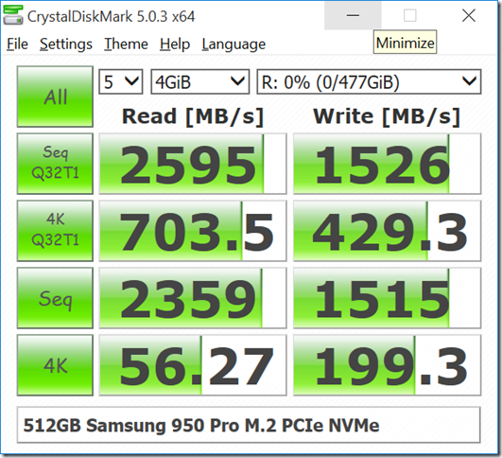
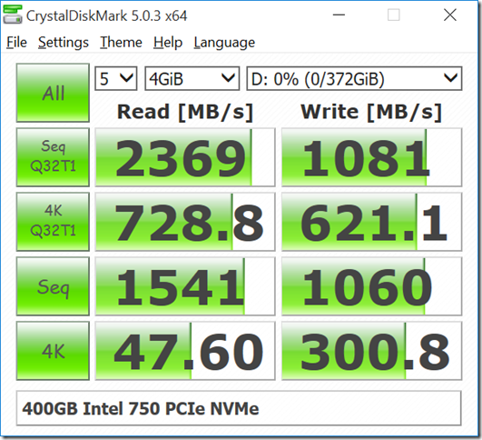
Device | Sequential Reads | Sequential Writes | Random Reads | Random Writes
512GB Samsung 950 Pro | 2595 MB/s | 1526 MB/s | 171755.6 IOPS | 104801.3 IOPS
400GB Intel 750 | 2369 MB/s | 1081 MB/s | 177938.0 IOPS | 151642.1 IOPS
512GB Samsung 850 Pro | 1104 MB/s | 532 MB/s | 100420.4 IOPS | 60765.1 IOPS
6TB WD Red HD | 176 MB/s | 170 MB/s | 386.7 IOPS | 448.2 IOPS

Slide 15
CrystalDiskMark vs. Hard D Benchmark
Hard D Benchmark performs sequential or random read & write tests.
3 available options:
Quick Test
Sequential Test
Random Test
Key features:
The user can change the size of the file and the buffer size.
Simplicity in UI – run a series of tests just by clicking a button,
Interactive graph that shows the speed of the operation
Wide range of customization- select different buffer and file sizes
Interactive graph- the user can zoom in and see in rich detail every spike in the IO operation, the graph can be saved as different formats (PNG,SVG,PDF).
Results are in easy to read, showing the maximum, minimum and average speed in MB/s and a chart of the load on the disk while the test is running.

Slide 16
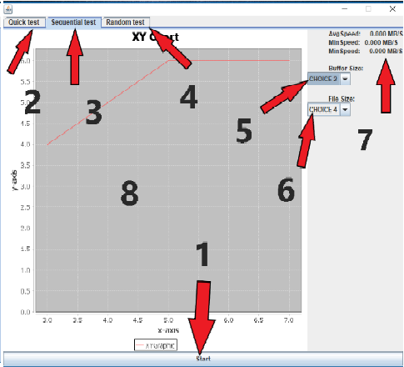
4. USAGE
Start button
Quick test file
Sequential test file
Random test file
Buffer size selection
File size selection
Min/Max/Avg speed
Read/Write speed graph

Slide 17
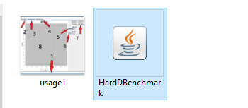
Steps
Launch Hard D Benchmark by double-clicking HardDBenchmark.jar icon .

Slide 18
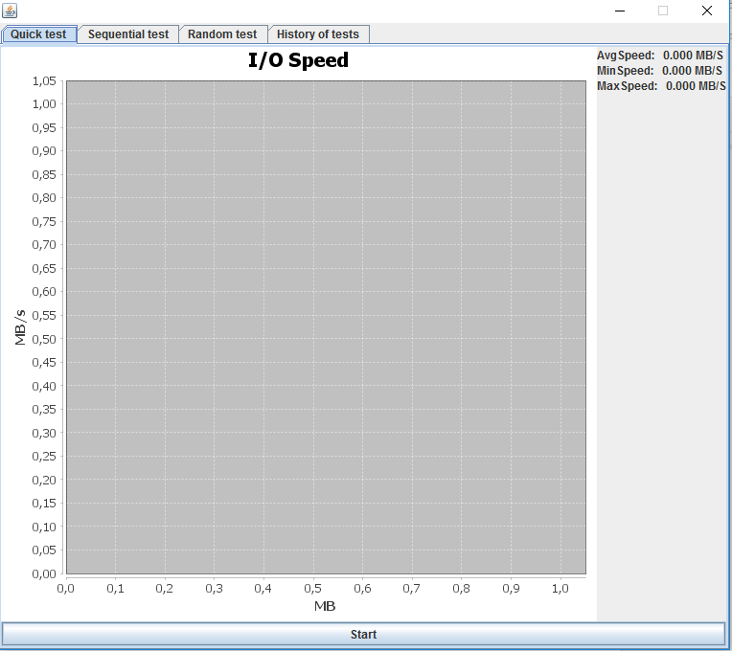
2. Click the Start button to run a Quick test for your hard drive.

Slide 19
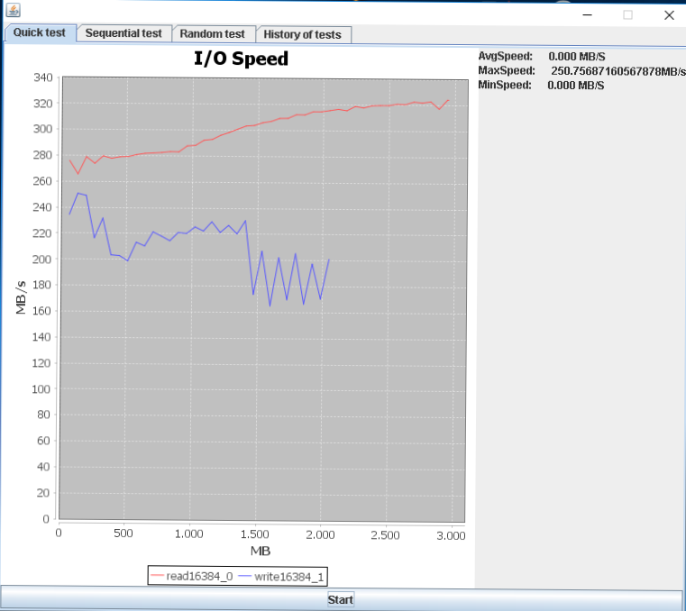
3. A graph is being plotted on your screen and the min/max/average speed is displayed for your hard drive.

Slide 20
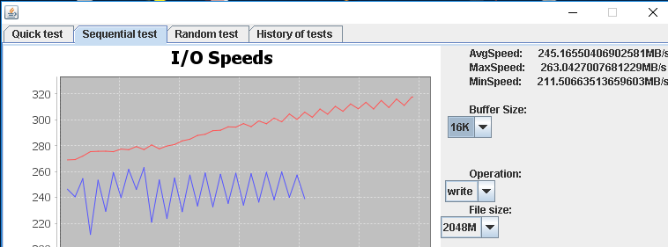
4. (Optional, for advanced testing) Click Sequential test or Random test if you want to use a different, more specific kind of test for your hard drive. Use Buffer size and File size options to set the size of the file and buffer that you wish to use, then Start to run the benchmark

Slide 21
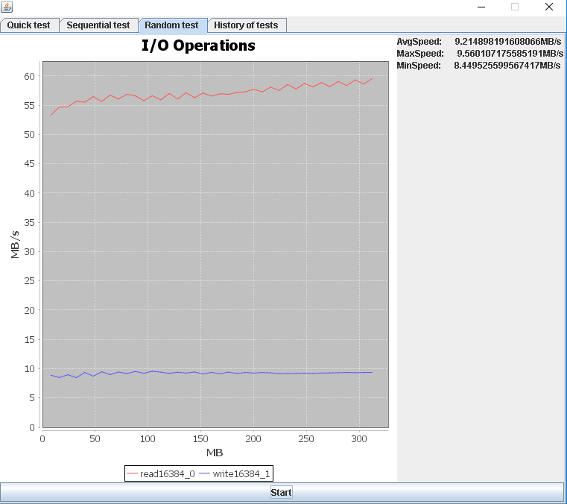
5. The output of the Hard D Benchmark is a graphical representation of the speed of your disk in MB/s as well as a display of your hard drive’s minimum, average and maximum speed.

Slide 22
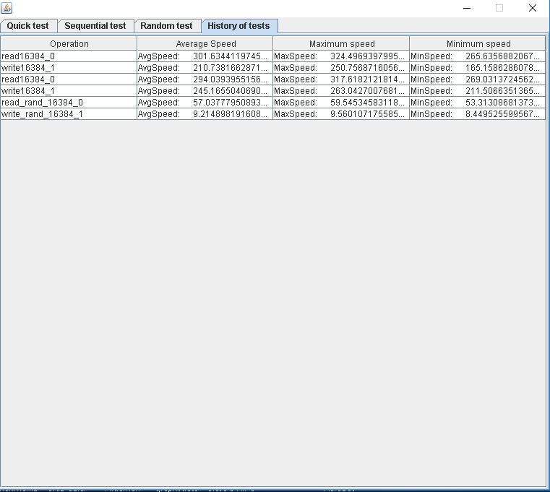
6. You can see a history of all your tests by clicking the History of tests tab.

Slide 23
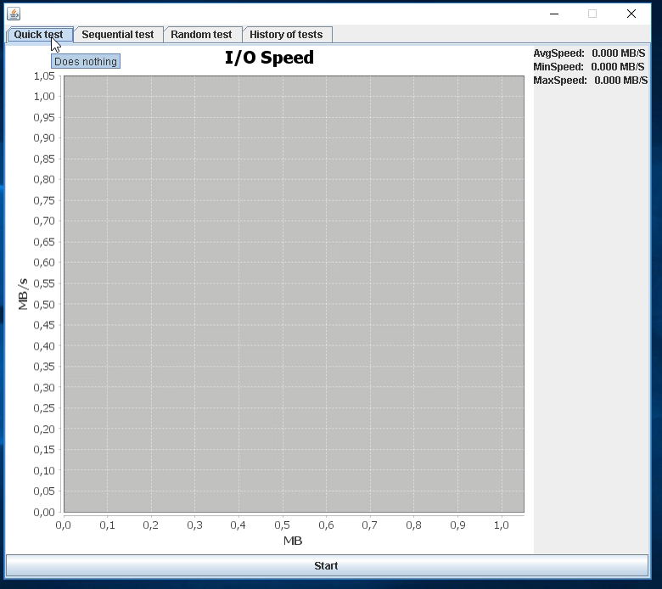
5. RESULTS

